Slide 1





FireBnB
Presented by Group 4:
Lee, Jonah
Biju, Berly
Dinh, Madeleine
Foo, Hazel
He, Chloe
Course: INSY661-075 Capstone Project

Slide 2
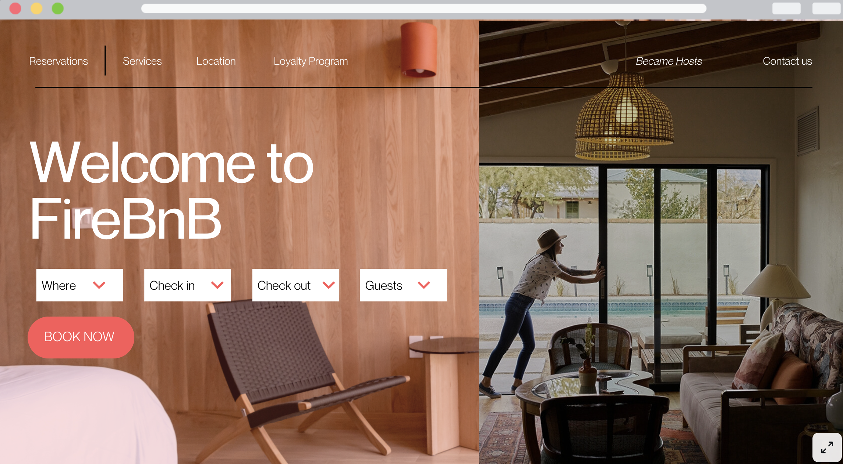
OUR MISSION
“
The mission of FireBNB is to facilitate a memorable and authentic accommodation for travelers, while empowering hosts to unlock their full potential of their spaces. We aim to create a global community where guests and hosts can connect in a safe and transparent environment, promoting cultural exchange and sustainable tourism.
“

Slide 3




Business Scenario
For guests
For hosts
Provides guests with access to a diverse range of unique properties beyond traditional hotels. Guests enjoy a personalized and authentic travel experience with the flexibility to choose short- or long-term stays and select from various amenities to customize their accommodations and make their stay more affordable and enjoyable.
Allows hosts to earn supplemental income by renting out properties, from spare rooms to vacation homes. Hosts control their listings, pricing, and availability, adjusting for demand and seasonality to maximize earnings. The platform’s global reach connects hosts with guests worldwide, offering a unique opportunity for cultural exchange.
FireBnB is an online marketplace that connects people seeking accommodations with those providing them, offering a user-friendly, transparent, and flexible platform.
Both guests and hosts benefit from COMPANY NAME's emphasis on protection and security. The review system fosters accountability by allowing users to rate and review each other, ensuring transparency and enhancing the platform’s safety and community feel.

Slide 4

Business Scenario
In terms of
Value Proposition…
Introduce the loyalty program for guests. For those who are frequent travelers or planning a trip with multiple stops, guests can subscribe to our tiered membership, which provides a discount on bookings to further promote our core value of enhancing the accommodation experience and create memorable stays.

Slide 5





Our Objectives
Giving Hosts the Voice
The database will give hosts flexibility to manage property listings, pricing, property types, and guest limits. It will store multiple amenities linked to each property, allowing hosts to maximize income and offer better hospitality while giving guests more options to search for specific features.
Ensure a Safe and Transparent Environment
The database will store reviews and ratings tied to specific bookings, fostering trust and transparency between guests and hosts, and building a safe community.
Innovate and Connect the World
The database will manage guest loyalty program subscriptions, applying tier-based discounts to bookings. This encourages frequent travelers to use the platform, fostering global connections and cultural exchanges.
Enhance the Accommodation Experience:
The database will manage property listings, amenities, and bookings, allowing guests to search and select properties. Each booking will be linked to a guest, property, and host, with details like check-in, check-out, and booking status (e.g., confirmed, cancelled, completed) accurately tracked for clarity.

Slide 6

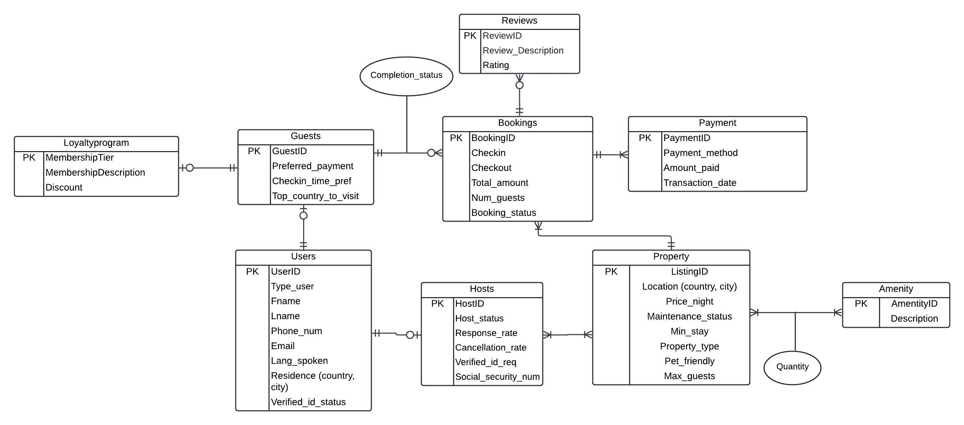
Entity-Relationship Diagram (ERD)
The ERD illustrates the relationships between key entities in the system: Guests, Hosts, Properties, Bookings, Payments, Reviews, and the Loyalty Program. The diagram reflects the relationships and cardinality between these entities.

Slide 7
Relational Schema
The relational schema for this database follows the ERD and ensures that the relationships between entities are captured through foreign keys. Each table will have a primary key, and foreign keys will be used to link tables, ensuring referential integrity.
Users (UserID (PK), Type_user, Fname, Lname, Phone_num, Email, Lang_spoken, Country, City, Verified_id_status)
Hosts (HostID (PK), Host_status, Response_rate, Cancellation_rate, Verified_id_req, Social_security_num)
Foreign Key: HostID references Users (UserID)
Loyaltyprogram (MembershipTier (PK), MembershipDescription, Discount)
Guests (GuestID (PK), MembershipTier, Preferred_payment, Checkin_time_pref, Top_country_to_visit)
Foreign Key: GuestID references Users (UserID), MembershipTier references Loyaltyprogram (MembershipTier)
Property (ListingID (PK), Location_country, Location_city, Maintenance_status, Min_stay, Property_type, Pet_friendly, Max_guests)
Host_Property ((HostID (PK), ListingID (PK))
Foreign Key: HostID references Hosts (HostID), ListingID references Property (ListingID)
Amenities (AmenityID (PK), Description)
Property_Amenities (ListingID (PK), AmenityID (PK), Quantity)
Foreign Key: ListingID references Property (ListingID), AmenityID references Amenities (AmenityID)
Bookings (BookingID (PK), ListingID, HostID, GuestID, Checkin, Checkout, Total_amount_ Num_guests, Booking_status, Completion_status)
Foreign Key: ListingID references Property (ListingID), GuestID references Guests (GuestID), HostID references Hosts (HostID)
Reviews (ReviewID (PK), Review_UserID, BookingID, Review_Description, Rating)
Foreign Key: Review_UserID references Users (UserID), BookingID references Bookings (BookingID)
Payments (PaymentID (PK), BookingID, Payment_method, Amount_paid, Transaction_date)
Foreign Key: BookingID references Bookings (BookingID)

Slide 8


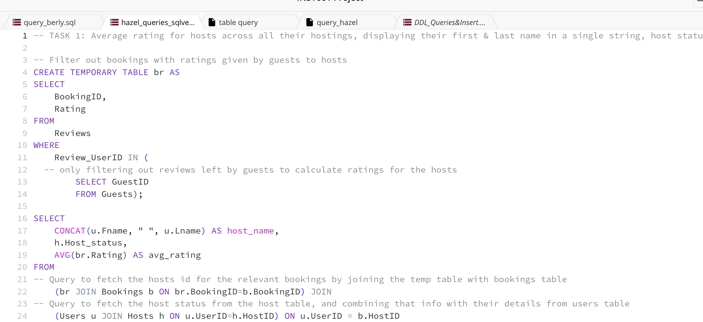
Key Insights:
Complex and Challenging SQL Queries

Slide 9
After a booking has been completed, guests and hosts have the choice to leave a review about their stay. From the business standpoint, we are interested to know how each host and guest felt about each of the completed stay to better understand the general sentiments with respect to their stay and the communication between the respective users.
This query retrieves and matches reviews for bookings where both guests and hosts have provided feedback, displaying the guests and hosts names, their reviews, and ratings in a single output, using multiple joins and temporary tables to ensure accurate pairing of reviews within each booking.
Task -- Display the listing ids, guests' first and last name in a single string, guests' ratings, hosts' first and last name in a single string and hosts' ratings for the stay(s).
CREATE TEMPORARY TABLE host_rv AS
SELECT u.Fname, u.Lname, r.BookingID, r.Review_Description AS host_review, r.Rating AS rating_from_host
FROM
-- JOINing reviews table with users table to retrieve hosts' names
Reviews r JOIN Users u ON r.Review_UserID=u.UserID
WHERE r.BookingID IN (
-- Select bookings with more than 1 review received ie 1 from guest, 1 from host
SELECT BookingID
FROM Reviews
GROUP BY BookingID
HAVING COUNT(*)>1
) AND
-- Hosts have IDs from 1-6
r.Review_UserID BETWEEN 1 AND 6;
SELECT
b.ListingID,
CONCAT(gr.Fname, " ", gr.Lname) AS guest_name,
gr.guest_review,
gr.rating_from_guest,
CONCAT(hr.Fname, " ", hr.Lname) AS host_name,
hr.host_review,
hr.rating_from_host
FROM
guest_rv gr, host_rv hr, Bookings b
-- Conducting 2 JOINs here. First to obtain both guest and host reviews and ratings into a single table using the 2 temp tables created. Then to retrieve the listing ID by joining with bookings table.
WHERE
gr.BookingID=hr.BookingID AND
b.BookingID=gr.BookingID;
--- Temporary table storing reviews given by guests
CREATE TEMPORARY TABLE guest_rv AS
SELECT u.Fname, u.Lname, r.BookingID, r.Review_Description AS guest_review, r.Rating AS rating_from_guest
FROM
---Joining reviews table with users table to retrieve guests' names
Reviews r JOIN Users u ON
r.Review_UserID=u.UserID
WHERE r.BookingID IN (
-- Select bookings with more than 1 review received ie 1 from guest, 1 from host
SELECT BookingID
FROM Reviews
GROUP BY BookingID
HAVING COUNT(*)>1
) AND
---Guests have user ids from 7-12
r.Review_UserID BETWEEN 7 AND 12;
-- Temporary table storing reviews by hosts
CREATE TEMPORARY TABLE host_rv AS
SELECT u.Fname, u.Lname, r.BookingID, r.Review_Description AS host_review, r.Rating AS rating_from_host
FROM
-- JOINing reviews table with users table to retrieve hosts' names
Reviews r JOIN Users u ON r.Review_UserID=u.UserID

Slide 10

Query 1 Learning Point
It was important to recognize that both hosts and guests can leave reviews, and these are stored together in the same table. We needed to filter these reviews into separate temporary tables to pair them side by side for each booking. This was more complex than other queries because we had to create separate tables for hosts and guests. However, this approach mirrors real-world scenarios where businesses analyze reviews from both parties to better understand their experiences and communication.

Slide 11
Since multiple properties are listed in each country, the performance of individual listings can vary significantly, especially when they are located in different states or regions. To better understand how each listing compares to others within its country, this query calculates the average rating for each property and the overall average rating across properties in the same country. The query uses multiple joins and window functions to provide a detailed view of property performance at both the individual listing level and the country level. Going further, it may be useful to refine this comparison by looking at average ratings within specific cities, which could provide a more accurate picture of how listings fare against each other locally.
TASK: Multiple properties can be listed within a single country, and each property has its own average rating calculated across ratings given by guests.
Generate an output displaying each listing's ID, its location (country and city), nightly rate, average rating from guests that stayed, as well as the average rating across all the properties based in that country. Make sure to express ratings to 2 decimals and arrange the final output according to the listing's country and city. Exclude properties that do not have any ratings in the output.
CREATE TEMPORARY TABLE collated AS
SELECT b.BookingID, b.ListingID, br.Rating
FROM
-- Joining table retrieved from subquery with bookings table to obtain the listing id associated with each booking that received a rating. Aggregate function is not performed on rating yet to perform average on 2 levels - across reviews for the same listing, and across reviews for listings in the same country.
Bookings b JOIN (
-- Subquery to retrieve table containing the booking ids and ratings received from guest reviews
SELECT
BookingID, Rating
FROM
Reviews
WHERE
Review_UserID IN (
-- only filtering out reviews left by guests to calculate ratings for the properties
SELECT GuestID
FROM Guests)
) br ON b.BookingID=br.BookingID;
SELECT
-- Ensure that only unique listing IDs are generated in output as the temp table would have contained multiple entries for certain listings as a result of multiple bookings
DISTINCT p.ListingID,
p.Location_country,
p.Location_city,
p.Price_night,
-- Perform average rating calculation for each listing based on the ratings received
ROUND(AVG(c.Rating) OVER(PARTITION BY p.ListingID),2) AS listing_avg_rating,
-- Perform average rating calculation for listings within each country
ROUND(AVG(c.Rating) OVER(PARTITION BY p.Location_country),2) AS country_avg
FROM
-- Perform JOIN function to retrieve information about each listing from the property table and combine that with the ratings received from guests
Property p JOIN
collated c ON p.ListingID = c.ListingID
ORDER BY
p.Location_country,
p.Location_city;

Slide 12
Query 2 Learning Point
Calculating two averages—one for each listing and one for the country—was challenging. If we first averaged the reviews for each property and then calculated the country's average based on those results, it could distort the overall rating. Initially, we wanted to include properties without reviews, but this made the calculation more complex and affected the accuracy of the country’s average. To simplify the task, we excluded those properties. This process was a valuable learning experience in managing complex calculations while maintaining accuracy.

